Slide 1

Introduction to Excel
Excel for Everyday Budgeting
Week 1

Slide 2
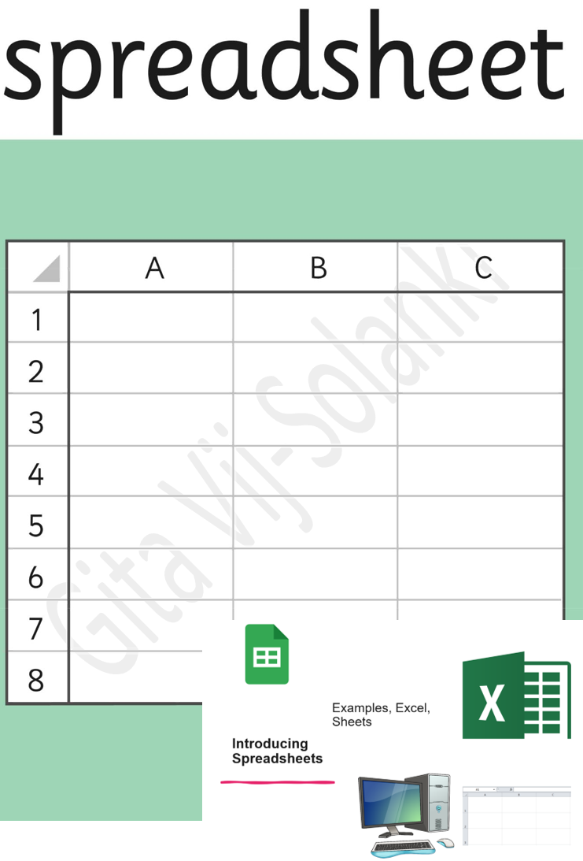

Slide 3
What is Excel?
Excel is a spreadsheet program.
It helps organise information.
It can do calculations for you.
Used for budgets, lists, and records.

Slide 4
Why Use Excel?
• Saves time
• Reduces mistakes
• Updates totals automatically
• Helps manage money

Slide 5
Understanding Cells
Each cell has a name.
Example: A1 (Column A, Row 1)
You type text or numbers into cells.

Slide 6
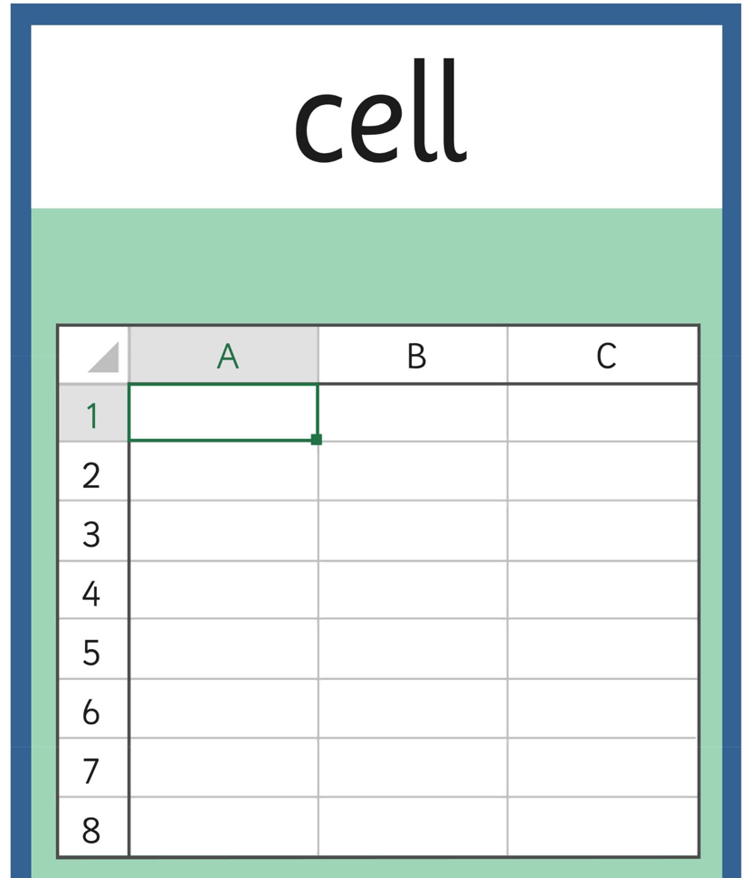

Slide 7
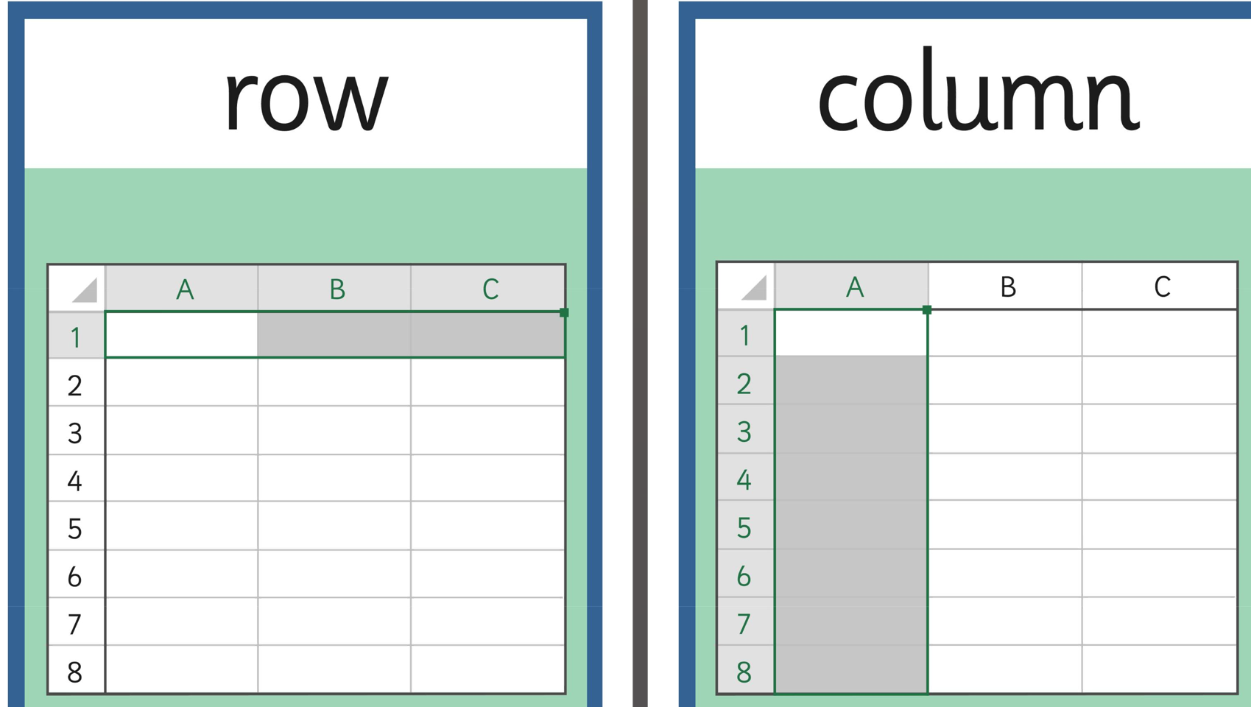

Slide 8
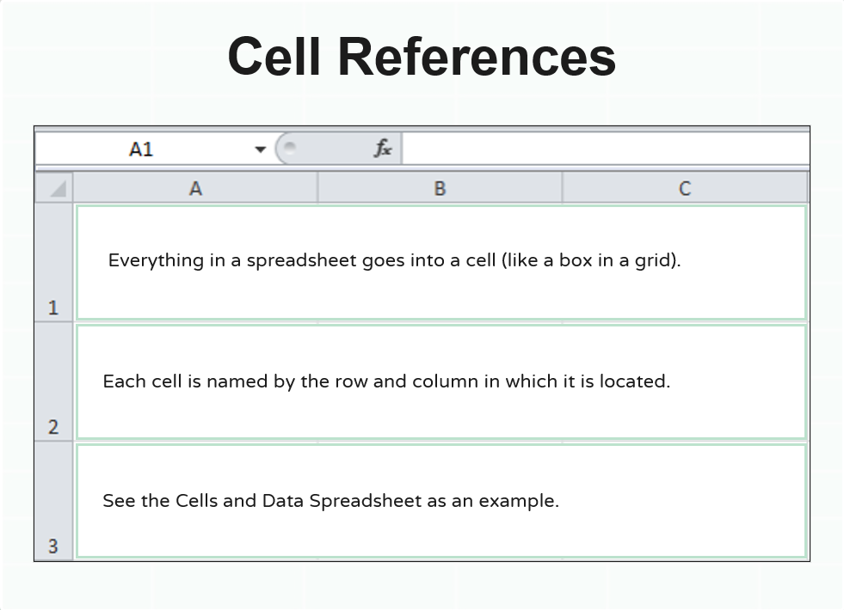

Slide 9
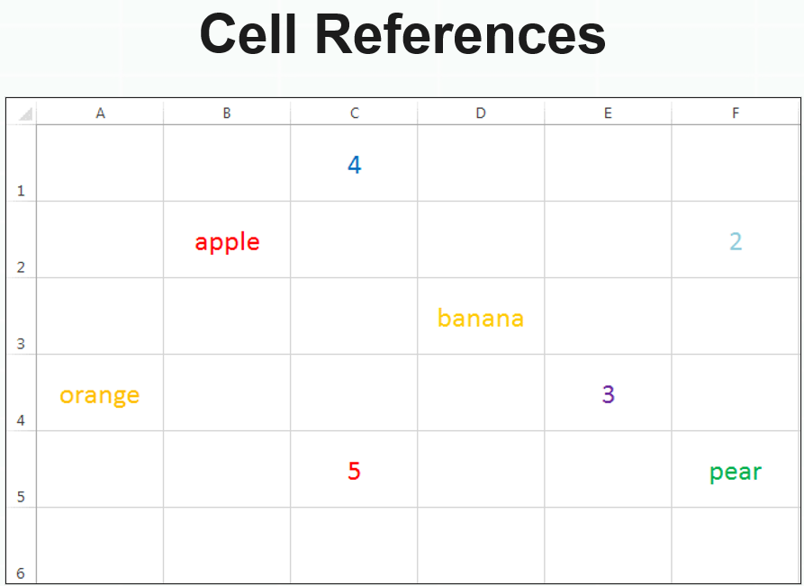

Slide 10
Entering Data
•Click on a cell
• Type your text or number
• Press Enter
• Click another cell to continue

Slide 11
Using Formulas
Formulas always start with =
=B1 + B2 (add)
=B1 - B2 (subtract)
=B1 * B2 (multiply)
=B1 / B2 (divide)

Slide 12
Excel Does the Maths
If you change a number,
Excel updates the answer automatically.
This is useful for budgets.

Slide 13
Saving Your Work
• File → Save As
• Choose your folder
• Name your file clearly
Example: Week1_Budget_YourName.xlsx

Slide 14
Today You Will
• Enter data into Excel
• Use simple formulas
• Create a basic budget
• Save your work confidently

