Slide 1

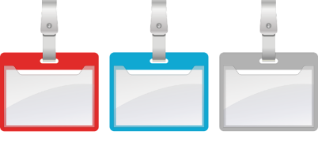
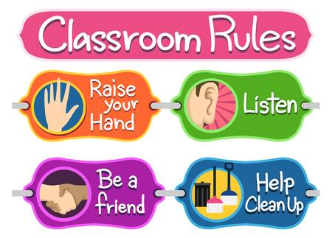
Classroom Rules
Arrive on time
Wear lanyards
Mobiles on silent
Bags under desk
No food or drinks near ICT equipment.
Bring correct stationary (pens, folders etc)
Be respectable to others
Reporting safeguarding concerns? Or colleagues' concerns?

Slide 2

Session Two:

Slide 3
📁 Session 2: Files and Folders (Introduction)
Session Overview
In this session, you will learn how to organise your work using files and folders. This will help you keep your documents safe, easy to find, and well organised.

Slide 4
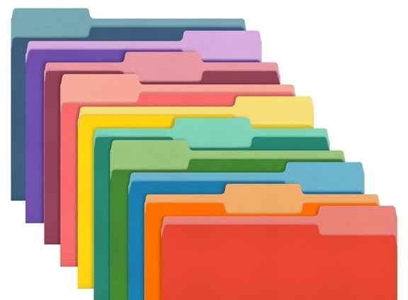
💡 Why is this important?
Organising your files helps you:
Find your work quickly
Avoid losing important documents
Work more confidently on a computer
🛠️ What you will do
Create your own folder
Save a document inside your folder
Practise opening and closing files
Complete a simple task to check your understanding

Slide 5
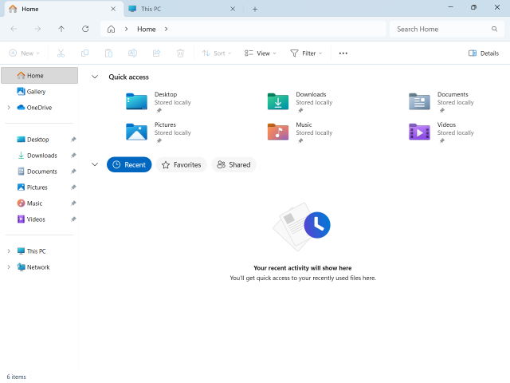
📁 How to Create a New Folder (Using File Explorer)
🖥️ Step 1: Open File Explorer
Look at the bottom of your screen (taskbar)
Click the yellow folder icon 📁
👉 This is called File Explorer

Slide 6
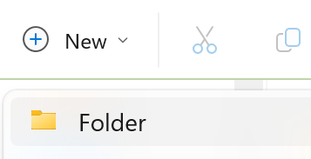
📂 Step 2: Choose where to create your folder
On the left side, click:
👉 Documents (recommended)
OR
👉 Desktop
➕ Step 3: Create a new folder
At the top of the screen, click New
Click Folder
A new folder will appear

Slide 7
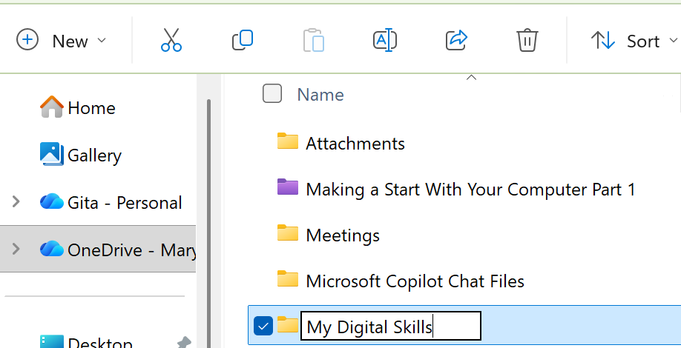
✏️ Step 4: Name your folder
Type a name (for example: My Digital Skills)
Press Enter
📂 Step 5: Open your folder
Double-click your folder
It will open so you can save your work inside
✅ Well done!
You have created and opened a folder 🎉
⚠️ Tips
Use Documents to keep your work safe
Give your folder a clear name
Take your time — no need to rush 😊

Slide 8
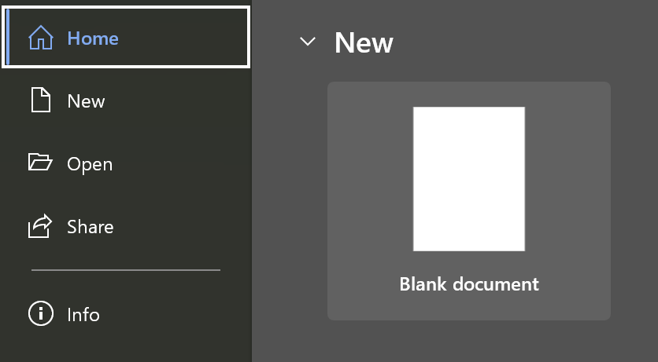

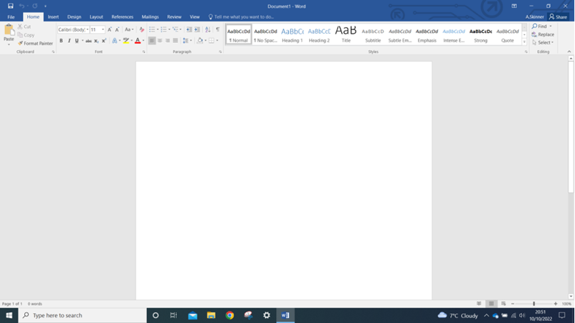
💾 How to Save a Document in Your Folder
📝 Step 1: Open a document
Open Microsoft Word
Click Blank document
⌨️ Step 2: Type some text
Type your name
Type a short sentence
👉 Example: I am learning digital skills
This Photo by Unknown Author is licensed under CC BY-SA-NC

Slide 9
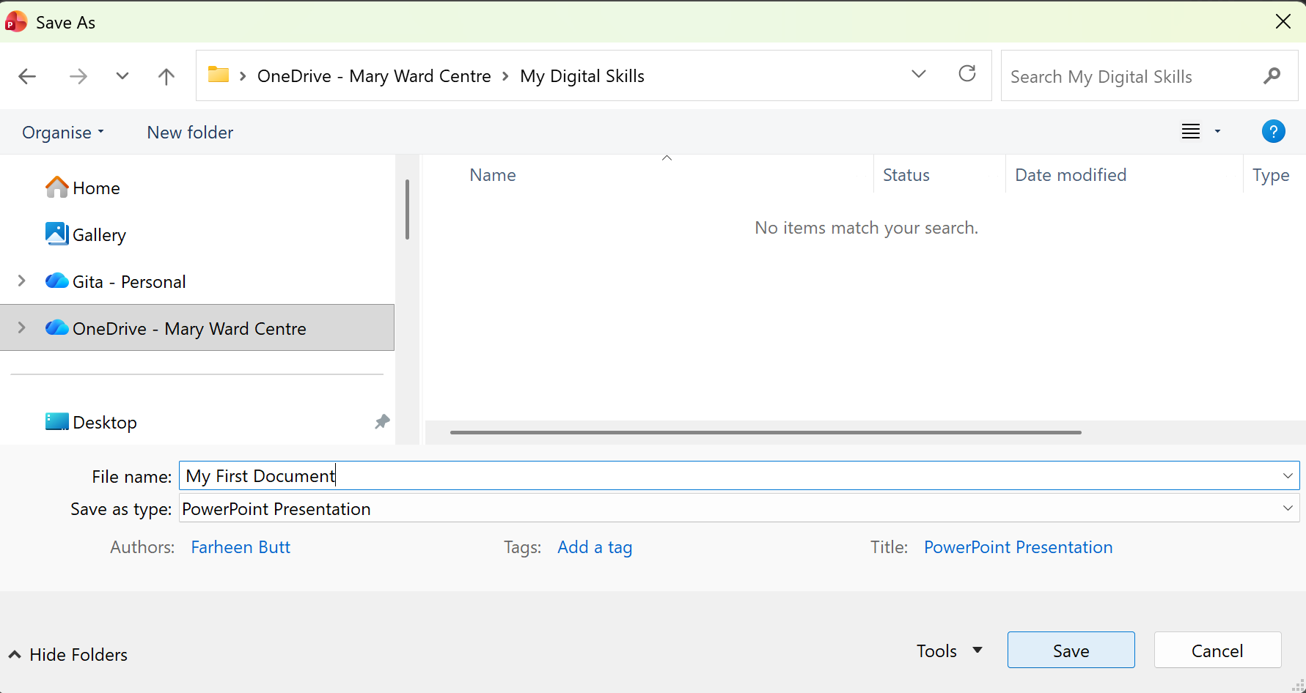
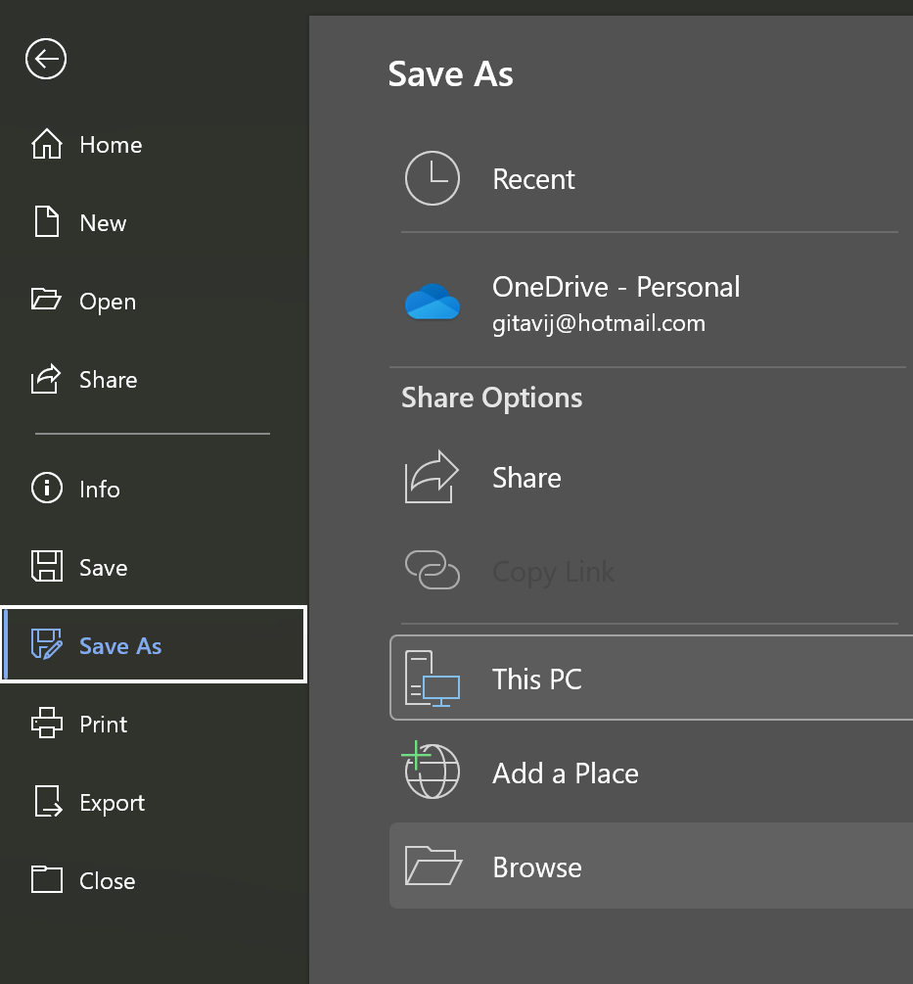
💾 Step 3: Save your work
Click File (top left)
Click Save As
✏️ Step 5: Name your file
Type a file name
👉 Example: My First Document
Click Save
📂 Step 4: Choose your folder
Click Browse
Click Documents
Find your folder (e.g. My Digital Skills)
Double-click to open it

Slide 10
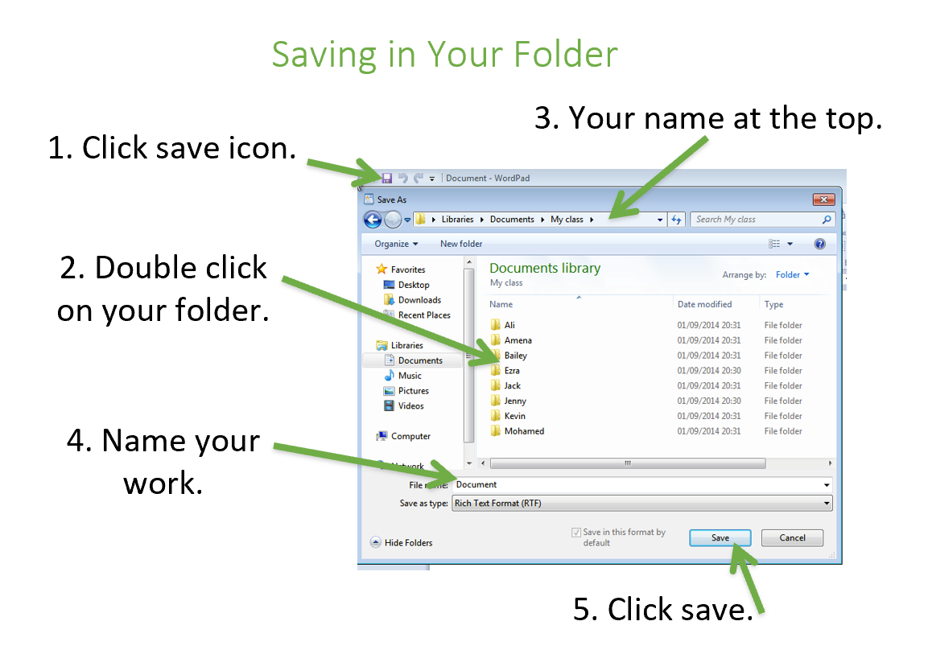
✅ Well done!
Your document is now saved in your folder 🎉
🔍 Check your work
Open File Explorer 📁
Go to Documents
Open your folder
You should see your file inside

Slide 11
Tutor: Gita Vij-Solanki
Email: gita.vij-solanki@marywardcentre.ac.uk

